Slide 1

Graph Algorithms
Mathematical Structures for Computer Science
Chapter 7
Copyright © 2014 W.H. Freeman & Co. MSCS Slides Section 7.4

Slide 2
Graph Traversal
Graph traversal is the process of writing out all the nodes of a simple, connected graph G in some orderly way.
Like previously covered tree traversal (Section 6.2). algorithms, the two algorithms here generalize traversal to apply to any graph. They are:
  Breadth First Search
  Depth First Search
Section 7.4
Traversal Algorithms

Slide 3
Depth-First Search
In the depth-first search algorithm for graph traversal, we begin at an arbitrary node a of the graph, mark it visited, and write it down.
We proceed as far as possible until there are no more unvisited nodes on that path.
We then back up the path, at each node exploring any new side paths, until finally we retreat back to a.
We then explore any new paths remaining from a.
The algorithm can be explained formally using recursion.
Section 7.4
Traversal Algorithms

Slide 4
Depth First Search
ALGORITHM DepthFirst
DepthFirst(graph G; node a)
//Writes nodes in graph G in
//depth-first order from node a
mark a visited
write(a)
for each node n adjacent to a do
if n not visited then
DepthFirst(G, n)
end if
end for
end DepthFirst
Section 7.4
Traversal Algorithms

Slide 5
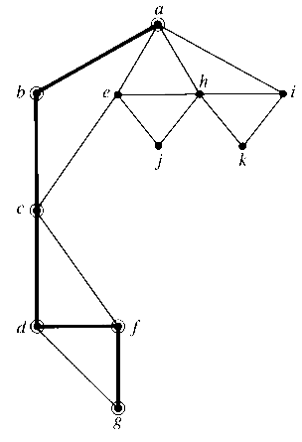
Depth First Search Example
Given the following graph, the algorithm operates as shown (starting with a)
We first mark that we have visited a, then arbitrarily choose an adjacent node, either b, e, h, or i.
Then we invoke the depth-first search algorithm beginning with node b, mark it, and choose an adjacent node (a or c).
Node a is adjacent to b, but it is marked, so c is chosen.
Node c leads to Nodes d or f then g.
Section 7.4
Traversal Algorithms

Slide 6
Depth First Search Example
When we get to node g, we have reached a dead end because there are no unvisited adjacent nodes, and the for loop of the instance of the algorithm invoked with node g is complete.
Node g was (one of) the unmarked nodes adjacent to node f, and we are still in the for loop for the instance of the algorithm invoked with node f.
We complete the for loop and thus the algorithm for node f, backing up to node d.
The same thing happens with node d, and we end up at node c.
The only unmarked node adjacent to node c is node e.
The process continues with node e leading to the remainder of the nodes.
Section 7.4
Traversal Algorithms

Slide 7
Breadth-First Search
In breadth-first search, beginning at an arbitrary node a, we first fan out from node a to visit nodes that are adjacent to a, then we fan out from those nodes, and so on.
To write the breadth-first search algorithm in an elegant fashion, we use a queue structure.
A queue is simply a line in which new arrivals are added at the back and departures take place at the front.
The addition of an entry at the back of a queue is called an enqueue operation, and a departure from the front of the queue is called a dequeue operation.
enqueue(a, Q) denotes adding a to the end of a queue called Q, and dequeue(Q) denotes removal of the entry currently at the front of Q.
front(Q) returns the value of the entry currently at the front of Q but does not remove that entry.
Section 7.4
Traversal Algorithms

Slide 8
Breadth-First Search Algorithm
ALGORITHM BreadthFirst
BreadthFirst(graph G; node a);
//writes nodes in graph G in breadth-first order from node a
Local Variable:
queue of nodes Q
initialize Q to be empty
mark a visited
write(a)
enqueue(a, Q)
while Q is not empty do
for each node n adjacent to front(Q) do
if n not visited then
mark n visited
write(n)
enqueue(n, Q)
end if
end for
dequeue(Q)
end while
end BreadthFirst
Section 7.4
Traversal Algorithms

Slide 9
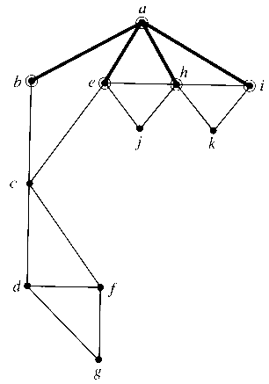
Breadth-First Search Example
Given the following graph, the algorithm operates as shown (starting with a)
We first mark that we have visited a, write it out, and add it to the queue.
We then write out all the nodes adjacent to a, (b,e,h,i) and add them to the queue, a is then removed from the queue
Section 7.4
Traversal Algorithms

Slide 10
Breadth-First Search Example
The new front of the queue is b, it is only adjacent to node c, which is written and added to the end of the queue, b is removed from the queue.
The queue now has e, h, i, c
This continues until the queue is empty, causing the while loop to terminate.
Section 7.4
Traversal Algorithms

Slide 11
Graph Traversal Algorithm Analysis
Suppose the graph contains n nodes, m arcs and is stored in an adjacency list.
There are n adjacency lists, so the amount of work is at least Θ(n) because each adjacency list must be checked, even if it turns out to be empty.
Because there are m arcs, the work in traversing the total length of all the adjacency lists is at least Θ(m).
Therefore both depth-first search and breadth-first search are Θ(max(n, m)) algorithms.
Section 7.4
Traversal Algorithms

